Slide 1
NSS activities at glance
2023-24

Slide 2
NSS ACTIVITIES
Health Awareness
Orientation Programs
NSS Special Camps conducted every year
Awareness Camps
Tree Plantations
Poster Making Competitions
Village visit to aware people about cleanliness
Encouraging youth to enthusiastically in the process of national development
Developing leadership qualities
Expert Talks on various important topics

Slide 3
Educational Event for National Cancer Awareness Day
11.07.2023
On National Cancer Awareness Day, we conducted educational event emphasizing early detection and healthy lifestyles. Collaborations with cancer organizations provided valuable support and information.

Slide 4
FIRST AID TRAINING IN COLLABORATION WITH RED CROSS
05.08.2023
Basic First Aid Training Session Held in Collaboration with Red Cross. Participants learned essential first aid skills, including CPR and wound care, to handle emergency situations effectively. This session aimed to enhance safety and preparedness in our community

Slide 5
TREE PLANTATION
DRIVE
08.08.2023
Our volunteers planted trees to make our environment greener. Together, we're fighting climate change.

Slide 6
DRUG
DE-ADDICTION PLEDGE
Organizing a drug de-addiction pledge in all NSS units of MRSPTU aims to raise awareness and promote a drug-free society. This initiative empowers students to commit to healthy lifestyles and responsible choices, fostering a safer campus environment.
09.08.2023

Slide 7
importance of organs donation
SIGNIFICANCE OF ORGAN
DONATIONN MEET
Organ donation is a critical act that saves lives and improves the quality of life for individuals suffering from organ failure or severe health conditions.
24.09.23

Slide 8
CLEANUP CAMPAIGN IN PARTNERSHIP WITH N.B.P MAINTENANCE SOCIETY"
01.10.2023
The "Cleanup Campaign with N.B.P Maintenance Society" focused on enhancing local cleanliness through collaborative efforts. Volunteers joined forces to remove litter and improve the community environment.

Slide 9
WINTER CLOTH DONATION
31.10.2023

Slide 10
DRUG FREE INDIA PLEDGE
25.01.2024

Slide 11
KITE FLYING COMPETITION AND FUN EVENT
KITE FESTIVAL
08.02.2024

Slide 12
WOMEN'S DAY: EARLY
CANCER DETECTION CAMP
07.03.2024
Nss wing of MRSPTU has organised camp on 7 March 2024 for the celebration of Women's day on early detection of cancer in females. Dr. Sapna Marcus Bhatti Radiation oncology, Aiims bathinda was the expert of the event. she explained the reasons of breast cancer and how to prevent it. Lecture was very knowledgeable for the females. Female faculty, staff members and students were invited to attend the camp in committee room of gzsccet from 12.00 noon onwards .

Slide 13
7 DAY CAMP
The National Service Scheme (NSS) unit organized
a 7-day camp , focusing on community service,
self-development, and teamwork. The camp
engaged volunteers in a series of activities
aimed at improvement and social awareness.

Slide 14
DAY 1
CLEANLINESS DRIVE
17.03.2024
On the first day of the NSS camp, volunteers organized a cleanliness drive in the local community.

Slide 15
DAY 2
YUVA SAMVAD
18.03.2024
Yuva Samvad, an open dialogue session where young volunteers discussed pressing social issues and shared ideas for community development

Slide 16
DAY 3
PLANTATION DRIVE
19.03.2024
Volunteers planted saplings around the grounds, focusing on enhancing the green cover and promoting environmental sustainability. They were educated on the importance of trees in maintaining ecological balance and combating climate change.

Slide 17
CONSTRUCTION SEWA AT NEARBY GURUDWARA
DAY 4
20.03.2024
The team helped with tasks such as carrying materials,
cleaning the construction site, and supporting skilled workers.

Slide 18
DAY 5
EXPERT TALK ON FIRST AID AND ROAD SAFETY AWARENESS
21.03.2024
Volunteers received practical
demonstrations on administering
basic first aid, including CPR and
treating wounds. A road safety
workshop emphasized the
importance of following
traffic rules, wearing helmets
and seat belts, and avoiding
distractions while driving.

Slide 19
DAY 6
BLOOD DONATION CAMP
22.03.2024
Volunteers received practical
demonstrations on administering
basic first aid, including CPR and
treating wounds. A road safety
workshop emphasized the
importance of following
traffic rules, wearing helmets
and seat belts, and avoiding
distractions while driving.

Slide 20
DAY 7
VISIT TO QILA MUBARAK
23.03.2024

Slide 21
GENERAL HEALTH
CHECKUP CAMP
Nss wing organized cardiac and general check up with the collaboration of Max hospital in dispensary.
22.03.2024

Slide 22
COMMUNITY
SERVICES

Slide 23
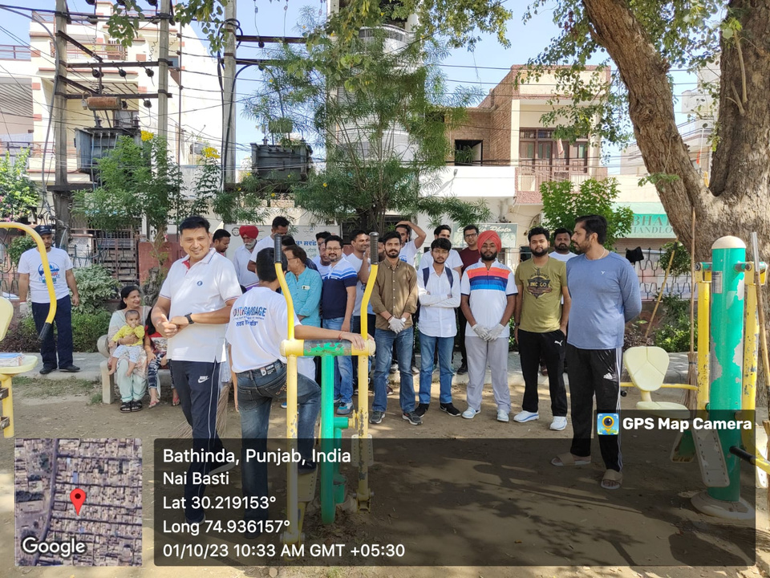
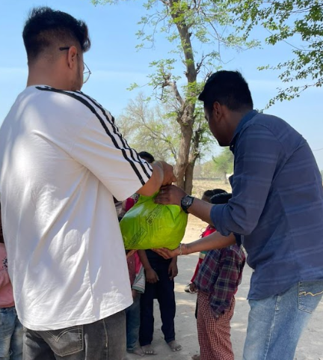

Slide 24
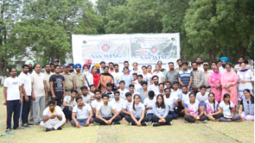
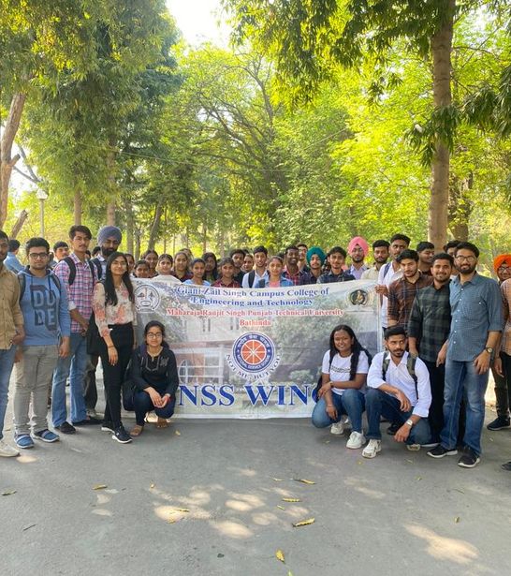

Slide 25
THANK YOU

