Slide 1
Valuing Your Intellectual Property Rights Cell for IPR Promotion and Management (CIPAM) Department of Industrial Policy and Promotion Government of India Ministry of Commerce and Industry

Slide 2
Acknowledgement & Disclaimer
This training initiative has been taken by CIPAM (Cell for IPR Promotion and Management), DIPP, Ministry of Commerce & Industry (Government of India) under the National IPR Policy to create public awareness about economic, social and cultural benefits of IPRs among all sections of the society.
CIPAM is thankful to International Trademark Association (INTA) and Jindal Global Law School, Sonipat for their immense support and valuable suggestions.
Whilst the slide presentation and related text material is attributed to CIPAM, CIPAM does not take any responsibility of the oral representations, statements, and/or any mannerisms of the trainers.

Slide 3
What is Intellectual Property (IP)?
IP means the property which is created with intellect such as inventions, books, paintings, songs, symbols, names, images, or designs used in business , etc.
Legal rights conferred on such property are called “Intellectual Property Rights” (IPRs).
IPRs are territorial in nature. For protection of your IP in any country, one has to seek protection separately under the relevant laws. There are special mechanisms in place in various territories for providing protection to different types of IPRs.
Notes:
Intellectual property rights are like any other property right. They allow creators, or owners, of patents, trademarks or copyrighted works to benefit from their own work or investment in a creation.
IP is a property which cannot be touched or seen and is product of a persons intelligence, hard work, and skill.
Like real property:
It can be bought, sold, licensed, exchanged, given away.
The owner can prevent unauthorized use and can take legal action, in case someone else uses it without permission.
The word intellect refers to creations of mind.
Intellectual Property is a type of intangible property and includes inventions, literary and artistic works, symbols, names and paintings.
Intellectual property rights (IPRs) are the protection granted to the creators of Intellectual Property (IP) by the Government.
IPRs are territorial in nature. For protection of IP in any country, one has to seek protection separately under the relevant laws. There are special mechanisms in place in various territories for providing protection to different types of IPRs.

Slide 4
What are the types of IPRs?
COPYRIGHT
TRADEMARK
GEOGRAPHICAL INDICATION
DESIGN
PATENT
SEMICONDUCTOR IC LAYOUT DESIGN
TRADE SECRET
PLANT VARIETY
Notes:
Types of Intellectual Property Rights:
Patents, Designs, Trademarks, Copyrights, Geographical Indications, Semiconductor Integrated Circuit Layout Designs, Plant Varieties, Trade Secrets.
Benefits of IP registration:
Economic benefits: IP rights enable creators to protect and monetize their creations. Third parties cannot use this creation without authorization from the creator.
Benefits consumers and society: Provides consumers with innovative products and services.
Innovation: Promotes innovation and increases funding for Research and Development.
Establishes Ownership: Assures a better licensing position.
Legal Benefits: Owners of IP can avail appropriate civil/ criminal remedies, if their rights are infringed.
Effects of Non-Registration/ Grant:
Difficult to obtain relief in case of infringement. Non-registered IPs have weak evidentiary value.
Only remedies under civil law can be availed. Owners cannot obtain remedies under criminal law (expect copyright which are not compulsory to register to seek remedies under criminal law).
Who Can Obtain Protection:
Any person(s) who is a creator of an original and creative or innovative work, having principal place of business in India or if he does not carry out business in India, has place of service in India can obtain such protection.
How are IPRs registered or granted in India:
All applications for IPRs need to be filed at the appropriate IPR office in the prescribed format. The application is examined as per the statutes and the IPR is granted/ registered or refused.

Slide 5
Copyright
Copyright is an exclusive legal right granted to creators on ‘expression of an idea’
Copyright owner has rights to reproduce, translate, adapt, perform, distribute and publicly display the work, etc.
Registration is not mandatory since copyright comes into existence as soon as the intellectual work is created
It is recommended to register a copyright for better enforceability, since registered copyrights have evidentiary value in Court
Notes:
As the author of the work, you alone have the right to do any of the following or to let others do any of the following:
To produce the work in a material form
To publish the work
To perform work in public
To produce, reproduce, perform or publish any translation of the work
To make any cinematograph film, or a record in respect of the work
To communicate the work by broadcast by radio, cable or satellite
To make any adaptation of the work
To do in relation to a translation or any adaptation of the work.
However, having a copyright registration is a strong proof of your ownership.
Mark your copyright work with the © symbol, your name of year of creation

Slide 6
Works covered under copyrights
Literary including Software – Books, Essay, Compilations, Computer Programs
Artistic – Drawing, Painting, Logo, Map, Chart, Photographs, Work of Architecture
Dramatic – Screenplay, Drama
Musical – Musical Notations
Sound Recording – Compact Disc
Cinematograph Films – Visual Recording which includes sound recording
Notes:
Literary Works: books, newspaper articles, blog posts, novels, poems, instruction manuals, speeches, computer software.
Musical works includes singing, music, but not song lyrics (these will be protected as literary works).
This means a work consisting of music and includes any graphical notation of such work but does not include any words or any action intended to be sung, spoken or performed with the music.
Activity: Does musical work include the lyrics of the following song?
Dramatic Works includes plays, screenplays, TV scripts, mime, theatrical performance, etc.
Artistic Works includes a painting, a sculpture, a drawing, an engraving or a photograph, work of architecture and any other work of artistic craftsmanship.
The paintings made by an artist is a part of his copyright.
Cinematograph Films- This means any work of visual recording and includes a sound recording accompanying such visual recording.
Sound Recordings- Means a recording of sounds

Slide 7
Works covered under copyrights
Literary, Dramatic, Musical or Artistic Works
Lifetime of the author and until 60 years from the death of the author
Anonymous & Pseudonymous Works
60 years from the year the work was first published
Works of Public Undertakings & Government Works
60 years from the year the work was first published
Works of International Organizations
60 years from the year the work was first published
Sound Recording
60 years from the year in which the recording was published
Cinematograph
Films
60 years from the year in which the film was published

Slide 8
Trademark
A trademark is any name, word, sound, numeral, colour, symbol or drawing (or their combination).
Trademarks let us identify the goods made or services offered by a company or an individual.
Trademark is registered for 10 years and can be perpetually renewed.
Notes:
Any sign, or any combination of signs, capable of distinguishing the goods or services of one product from another product, shall be capable of constituting a trademark.
Such signs, in particular words including personal names, letters, numerals, figurative elements and combinations of colors as well as any combination of such signs, shall be eligible for registration as trademarks.
A trademark should not be ‘identical’ or ‘similar’, see the previous slide which shows that a person buying the chips would be confused.
Following things can be registered as a trademark:
A word or a combination of words,
Letters,
Numerals,
Drawings,
Symbols,
Three-dimensional
In a single brand or logo, trademarks can let you know many things about a company’s reputation, products and services.
For example, “MAHARAJA MAC” is a word mark for burgers of the international fast food restaurant chain, McDonald's.
Other types of trademarks:
• A logo (for e.g., the “GOOGLE” logo on the slide)
• Packaging (for e.g. the “PEPSI” bottle packaging)
• A Service Mark (for e.g. “VODAFONE” for mobile phone services)
• Non-Traditional Trademarks: Even a sound, smell, color, color combination or a shape can be a trademark under certain circumstances (presenter can give examples of the “COCA-COLA” bottle shape, “MGM” lion roar soundmark, purple color mark of “CADBURY”)
A trademark is a mark accorded with protection, intended to serve the purpose of recognizing the source/origin of the goods or services to which the particular mark belongs.
4.) Trademark is a symbol of origin and source of a mark and bears the ‘stamp’ of quality. The trademark owner would always want to protect his mark from unfair usage and also from fraud and deceit.

Slide 9
Essentials of a Trademark
Advisable
Unique (E.g. Doordarshan )
Distinctive (E.g. BHIM, BHEL)
Non-dictionary words / Invented words
Custom designs
Devices or symbols (E.g. Make in India)
Non-descriptive (E.g. Goods)
Avoid
Adjectives (E.g. Efficient)
Names of person or places (E.g. Rahul Kumar)
Obscenity
Religious or Constitutional words or symbols (E.g. OM, Ashoka Chakra)
Common Shapes (E.g. Sphere)
Notes:
Can trademarks be entirely descriptive? Yes
Can trademarks be deceptively similar? No, because this could be misleading message and be potentially damaging to customers and business.
Can names of places be given as trademarks? No, a place name can be used if it is coupled with a “distinctive word”, e.g. Darjeeling Tea.
Can you appear superior to your competitors? No, such a trade mark may give you unfair advantage over your competitors. It could be deceptive.
Go for a trademark which is –
⬜ Easy to speak & spell (in case of word mark),
⬜ Appealing and easy to remember or recollect.
⬜ invented or coined word, unique monogram, logo or a geometrical device
Don’t go for a trademark which consists of –
⬜ laudatory or descriptive matters (such as best, perfect, super etc. words or pictures of the product concerned)
⬜ geographical names. common surnames, names of a community or persons
⬜ a matter prohibited by law to be used as a trademark
⬜ a matter that is same/similar to an already existing trademark in the market.

Slide 10
How to indicate your Trademark?
Trademark application has been filed
Registered Mark
The ™ sign is used when a trademark has been filed and the registration is under process
Once registered, ® symbol can be used which indicates that the brand name is registered now
Notes:
You recognize a registered trademark by the symbol of a circle-R following the trademark name or graphic image. The TM sign shows the brand name for an unregistered trademark classified as a product. The owner uses this sign to mark what they believe is their brand mark. Use the ® symbol once you register a trademark or service mark. It shows that the country authority has approved the registration.

Slide 11
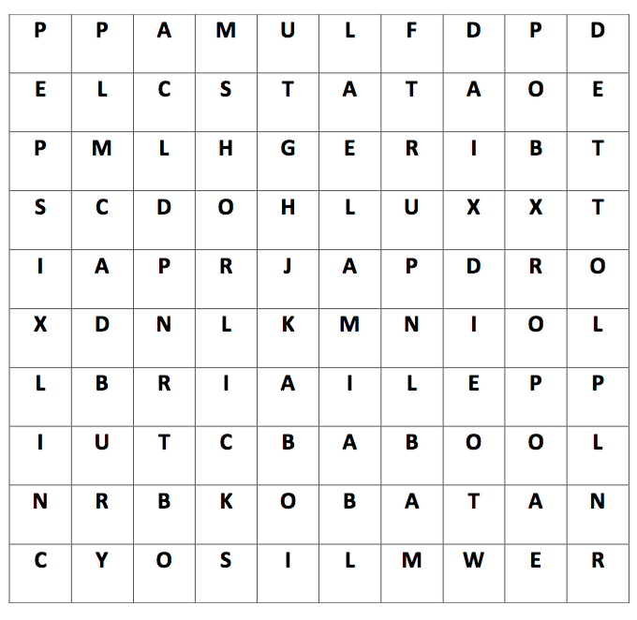
Activity: Find the famous Trademarks?

Slide 12
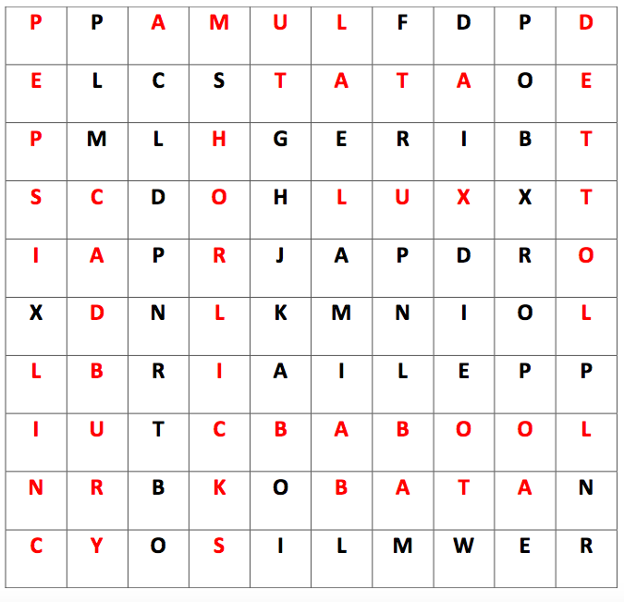
Activity: Find the famous Trademarks?

Slide 13
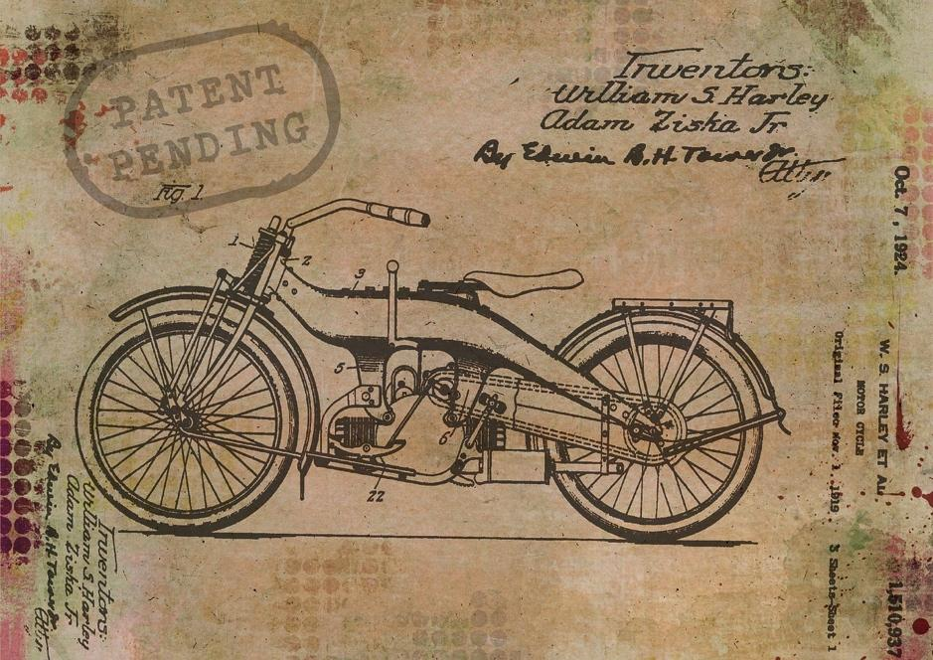
Patent
A ‘patent’ is an exclusive right granted which provides the exclusive ‘right to exclude’ all others and prevent them from making, using, offering for sale, selling or importing your invention.
For an invention to be patentable –
it must be new
non-obvious to any person who is skilled in the relevant field of technology
must be capable of industrial application
A patent is valid for 20 years, starting from the date of filing of the patent application and this term cannot be extended.
Notes:
An invention in simple terms refers to a new product or process, which is a technical advancement over the existing knowledge or has economic significance or both. For ex. television, telephone, internet, email, YouTube are all inventions.
For an invention to be patentable, it needs to satisfy 3 criteria:
It must be new, i.e. it is not something already existing in the current knowledge anywhere in the world, i.e. not in public domain in any form, before the filing of patent application. (Novelty)
It must be non-obvious to any person who is skilled in the relevant field of technology. That is, the standard is a person reasonably skilled in such field of study and not a layman. (Inventive Step)
Lastly, it must be capable of industrial application, i.e. capable of being applied to practical utilities and not just pure theory. (Industrial use)
A person who invents a new car engine to run with water or waste material can after getting it patented, further grant a license to use his technology to some big automobile company for certain amount of money. The automobile company can use this technology to build a new sector in the cars market.
A patent is valid within the territory of country where it is granted; however, protection can be availed in other countries by filing applications in relevant patent offices.
Development Commissioner (MSME), Ministry of MSME, Govt. of India has sponsored establishment of multiple Intellectual Property Facilitation Centres (IPFC) and Department of Science and Technology under Technology Information Forecasting and Assessment Council (TIFAC) has set up various Patent Facilitating Centres (PFC) throughout India

Slide 14
Non-patentable Inventions
A few examples of non-patentable inventions are:
A method of treatment of humans and animals
Inventions that cause serious prejudice to human, animal or plant life, or health or to the environment
Computer program per se or algorithms
Mere discovery of a new form of known substance
Mere admixture resulting in aggregation of properties mental act or method of playing game
Presentation of abstract ideas
Inventions containing traditional knowledge
Presentation of abstract ideas
Inventions contrary to natural Laws
Mathematical or business method
Method of agriculture
Inventions which fall under the Atomic Energy Act
Notes:
Sections 3 and 4 of the Patents Act deal with non-patentable inventions, the same being:
1. A frivolous invention or the one contrary to established natural laws is not patentable.
2. An invention whose commercial exploitation is contrary to public order and morality or which causes serious prejudice to human, animal, plant or the environment is not patentable.
3. Mere discovery of a scientific principle or the formulation of an abstract theory or discovery of any living thing or non-living substance occurring in nature is not patentable. For eg: discovery of some form of natural gas or element cannot be patented.
4. Mere discovery of any new form of a known substance which does not result in the enhancement of the known efficacy of that substance or mere discovery of any new property or new use for a known substance or of the mere use of a known process, machine or apparatus unless such process results in a new product or employs at least one new reactant cannot be patented. For Eg: crystalline form of a known substance.
5. Mere arrangement or re-arrangement or duplication of known devices, each functioning independently of one another in a known way.
6. A method of agriculture or horticulture.
7. Any process for the medicinal, surgical, curative, prophylactic diagnostic, therapeutic or other treatment of human beings or any process for a similar treatment of animals to render them free of disease or to increase their economic value or that of their products. For eg. process of carrying out a surgery or blood transfusion
8. Plants and animals as a whole or parts thereof other than micro-organisms but including seeds, varieties and species and essentially biological processes for production or propagation of plants and animals.
9. A mathematical method or business method or algorithms or computer programme per se.
10. A mere scheme or rule or method of performing a mental act or method of playing game. For eg. Method for calculating the addition of numbers.
11. Inventions which are of traditional knowledge or an aggregation or duplication of known properties of the traditionally known component or components.
12. Section 4 excludes inventions relating to atomic energy falling within Section 20(1) of the Atomic Energy Act, 1962. This section states that no patents shall be granted for inventions which in the opinion of the Central Government are useful for or relate to the production, control, use or disposal of atomic energy or the prospecting, mining, extraction, production, physical and chemical treatment, fabrication, enrichment, canning or use of any prescribed substance or radioactive substance or the ensuring of safety in atomic energy operations.

Slide 15
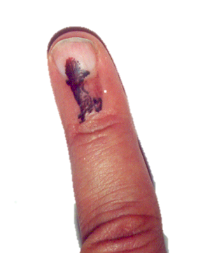
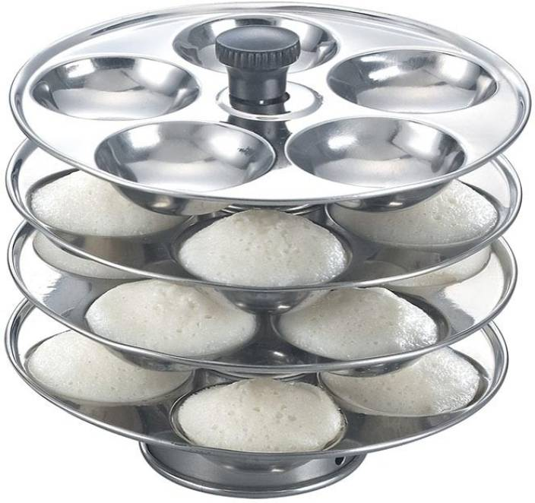
Some patented inventions
Notes:
I INDELIBLE INK
Used by the Largest Democracy in the World
National Physical Laboratory, New Delhi.
Licensee: M/s Mysore Paints & Varnish Ltd., Mysore
This ink is being used for election purposes for the last 40 years in India and abroad.
Ink is indelible because it contains a silver compound which chemically reacts with the pigment of the skin when exposed to light leaving a black colour on the skin.
The Ink is being used not only in India but is being exported to more than 25 countries II. Remote Controlled Power Tiller( RC-PT)
Remote Controlled System for Power Tillers is developed for making the work of farming easier, comfortable and safer. This is an electro-mechanical gadget which goes as an attachment for power tillers. This technology offers farmer to operates the power tiller from a far of point without even getting into the field and stand peacefully under a shade avoiding exposure to elements and irritating engine noise. This also eliminates the chances of injury to the operator while running behind the Power Tiller in uneven field. It is also quite helpful for women farmers.
III. CLOTH CLIP
IV. Idli Maker

Slide 16
Semiconductor Integrated Circuits Layout-Design
DEFINITION
ACT
CRITERIA FOR REGISTERATION
Semiconductor Integrated Circuit: A product having transistors and other circuitry elements designed to perform an electronic circuitry function
Layout Design: A layout of transistors and other circuitry elements including lead wires connected in a semiconductor integrated circuits
The Semiconductor Integrated Circuits Layout-Design Act (SICLDA), 2000 deals with ‘layout design’ used in semiconductor integrated circuit and are a form of intellectual property
The Act provides protection for a period of 10 years
Should be original
Should be distinctive
Should be capable of distinguishing from any other layout design
Should not have been commercially exploited anywhere in India or in a convention country
Notes:
Basics
Semiconductor Integrated Circuit (SIC) means a product having transistors and other circuitry elements, which are inseparably formed on or inside a semiconductor material or an insulating material and designed to perform an electronic circuitry function.
Sometimes called chips or microchips, these IC chips form an integral part of every electronic device like computers, television, electronic watch, mobile phones etc.
Semiconductor Integrated Circuits Layout Design is governed by following legislations
Semiconductor Integrated Circuits Layout Design Act 2000
Semiconductor Integrated Circuits Layout Design Rules 2001
Layout-Design of an SIC
The layout-design of a semiconductor integrated circuit means a layout of the arrangement of transistors and other circuitry elements expressed on a semiconductor integrated circuit.
Term of an SIC
The Act provides for registration period of ten years from the date of filing of an application from registration or from the date of its first commercial exploitation.
Commercial Exploitation here refers to acts of selling, leasing, offering or exhibiting for sale or otherwise distributing such SIC for commercial purpose. anywhere in India or in any country, whichever is earlier.

Slide 17
Design
a
Design should be applied or applicable to any article by an industrial process
It is registered for 10 years (can extend by 5 years)
Design is a shape, pattern, arrangement of lines or color combination which is ornamental in nature that is applied to any article
Notes:
Design
Basics
Industrial Designs are the features of shape, configuration, pattern, ornament or composition of lines or colours applied to the product which makes it look different from other articles in the market.
The purpose of industrial designs is to add on to the aesthetic value of the product to increase the marketability while making our life easier.
The Designs Act 2000 governs the provisions relating to designs in India and specifically mentions that the design to be registered must be visible on the finished article.
For a design to get registration, it should have the following features:
New - Must be new. A new design does not necessarily mean a completely new one, it can also be the application of a pre-existing design to a particular product for the first time
Original
Not Disclosed to public - It is imperative that the design must not have been published or disclosed anywhere else in the world before filing of registration
Distinct
Not against public morality
Not Functional in Nature - If any product has any functional feature without which the use of that product is not possible then the design of that functional aspect cannot be registered.
Benefits of Registration
Adds to aesthetic value of a product
Increases marketability of a product
Design registration can be used in Court
Provides an exclusive right in the market hence establishes a better license position
Term of Design
The design protection is provided for 10 years. The period of protection is extendable to 5 years after the expiry of 10 years’ duration.

Slide 18
Essentials of a Design
1. Eye-catching feature
2. New or original
3. Applicable to any article by an industrial process
4. Should not be functional or useful
5. Should not be of artistic nature like painting, sculptures, etc.
Notes:
CRITERIA FOR A DESIGN:
As per section 4 of Designs Act, 2000, a design which (a) is not new or original; or (b) has been disclosed to the public anywhere in India or in any other country by publication in tangible form or by use or in any other way prior to the filing date, or where applicable, the priority date of the application for registration; or (c) is not significantly distinguishable from known designs or combination of known designs; or (d) comprises or contains scandalous or obscene matter, shall not be registered.
Further, design should not attract the provisions of section 5 of Designs Act, 2000 i.e not contrary to public order or morality.
What can be registered as Design in India?
For a design to get registration, it should have the following features:
New - Must be new. A new design does not necessarily mean a completely new one, it can also be the application of a pre-existing design to a particular product for the first time
Original
Not Disclosed to public - It is imperative that the design must not have been published or disclosed anywhere else in the world before filing of registration
Distinct
Not against public morality
Not Functional in Nature - If any product has any functional feature without which the use of that product is not possible then the design of that functional aspect cannot be registered.
What cannot be registered as Design
Book covers
Calendars
Certificates
Medals
Greeting Cards
Postcards
Documents
Forms, etc.
The inside arrangements of a a product (say money purse, box or an almirah, etc.) are not designs under the Act as their design is not visible at the surface when put on display

Slide 19
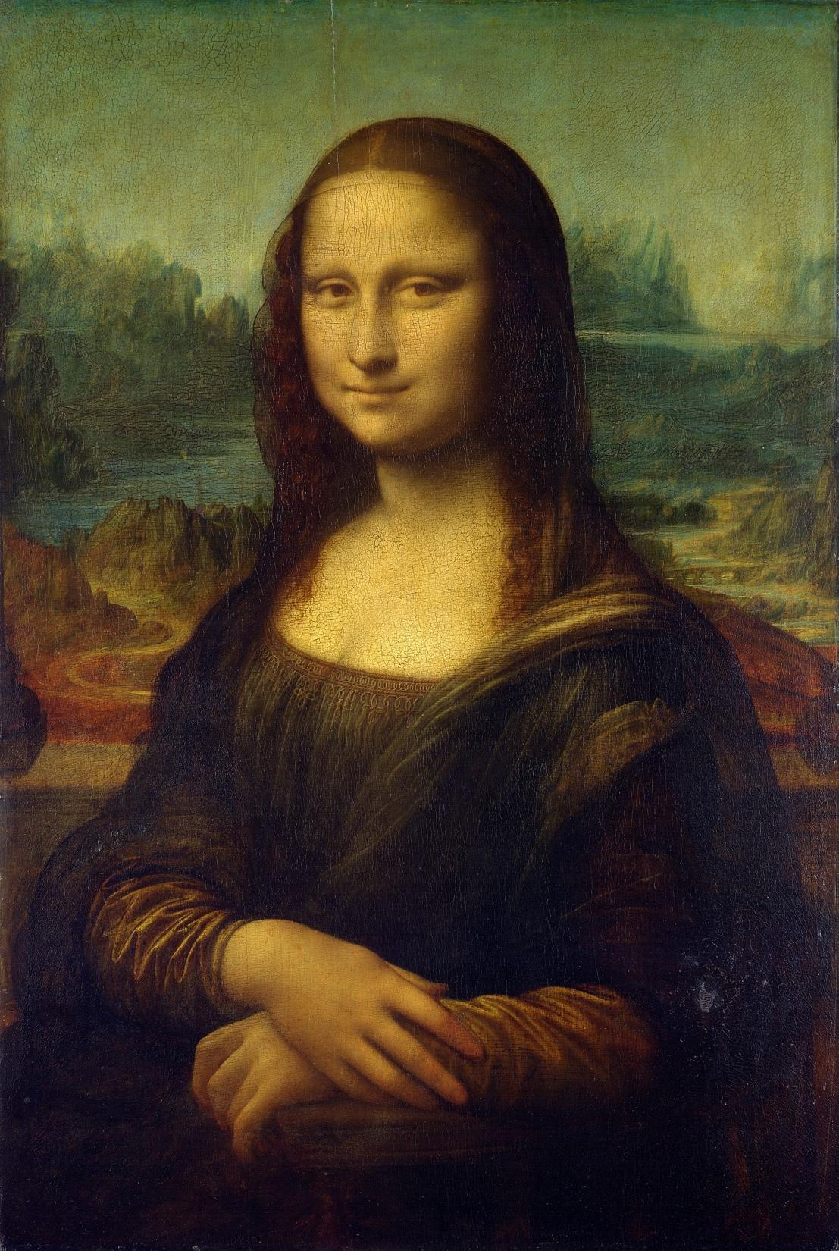
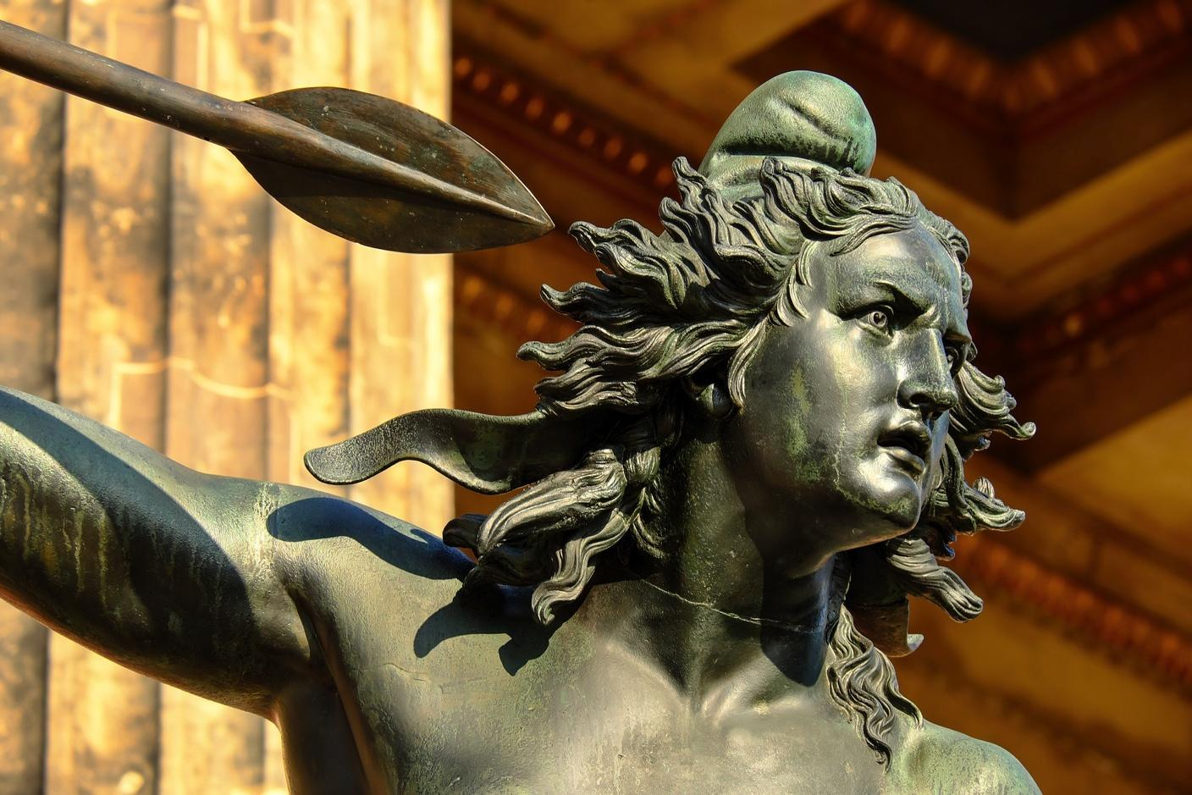
Point out the Industrial Design
1
2
3
4
5
Notes:
3 and 5 are Industrial Designs. 1 is a painting hence covered under copyrights.
4 is a branding logo protected under Trademarks

Slide 20
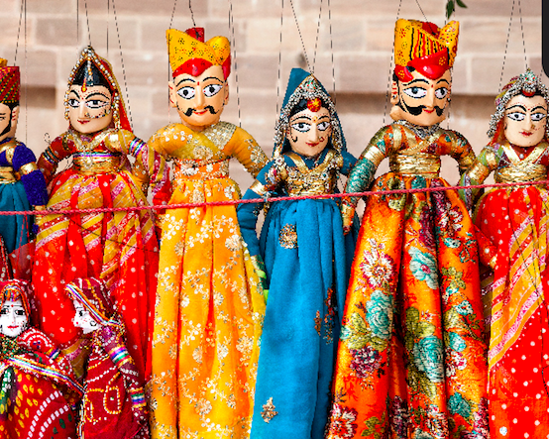
Geographical Indication
Mysore Silk
GI is a sign used on products that have a specific
geographical origin and possess qualities or a reputation that are due to that origin
Rajasthani Kathputlis
Naga Mircha
Darjeeling Tea
Notes:
Basics
Geographical Indication is primarily an agricultural, natural or a manufactured product (handicrafts and industrial goods) originating from a definite geographical territory.
Typically, such a name conveys an assurance of quality and distinctiveness which is essentially attributable to the fact of its origin in that defined geographical locality.
People with a malicious intention to sell other variety of teas with the title/label “Darjeeling” can be punished.
Some examples are Champagne Wine, Darjeeling Tea, Chanderi Saree, Kanchipuram Silk Saree, Nagpur Orange, Kolhapur Chappal, Bikaner Bhujia, Agra Petha, etc.
Term of a Geographical Indication
The registration of a geographical indication is valid for a period of 10 years. It can be renewed from time to time for further period of 10 years each.
Why should GI be protected in India?
Geographical Indications in India is protected under the Geographical Indications of Goods (Registration & Protection) Act, 1999 and the Geographical Indications of Goods (Registration & Protection) Rules, 2002.
India is a rich storehouse of goods with reputation for quality which can be adduced to their geographical origin or place of manufacture, need to protect Indian Treasures
The economic potential of these goods is enormous.
To prevent GI goods becoming generic
Need for a rule based system that is open, fair and provides for an enforcement mechanism

Slide 21
Essentials of Geographical Indication
Geographical Indication (GI) is primarily an agricultural, natural or a manufactured product (handicrafts and industrial goods) originating from a definite geographical territory
A product is considered to be manufactured in a territory if one of the activities of either the production or of processing or preparation of the goods takes place there
GI conveys an assurance of quality and distinctiveness which is essentially attributable to the fact of its origin in that defined geographical locality
GI promotes economic prosperity of producers of goods produced in a geographical territory
The registration of a GI is valid for a period of 10 years. It can be renewed from time to time for further period of 10 years each
Notes:
Benefits for Consumers: Certain goods have distinct characteristics due to its origin from a particular region. Growing demand for such products led to rise in counterfeit products. A GI conveys an assurance of quality and distinctiveness which is essentially attributable to the fact of its origin. A GI protects consumers from deceptive goods.
Under Articles 1 (2) and 10 of the Paris Convention for the Protection of Industrial Property, geographical indications are covered as an element of IPRs. They are also covered under Articles 22 to 24 of the Trade Related Aspects of Intellectual Property Rights (TRIPS) Agreement, which was part of the Agreements concluding the Uruguay Round of GATT negotiations.
Benefit of Registration of Geographical Indication
Confers legal protection to Geographical Indications in India
Prevents unauthorised use of a Registered Geographical Indication by others
Provides legal protection to Indian Geographical Indications which in turn boost exports.
Promotes economic prosperity of producers of goods produced in a geographical territory.
Difference between Geographical Indication and Trademark
A trade mark is a sign which is used in the course of trade and it distinguishes goods or services of one business with those of other businesses.
A geographical indication is an indication used to identify goods having special characteristics originating from a definite geographical territory.

Slide 22
Plant Varieties
India's Protection of Plant Varieties and Farmers' Rights Act of 2001 is the most far-reaching legislation with regard to establishing rights for farmers to save, use, exchange and sell farm-saved see.
Such protection is a unique aspect of Indian IP Regime which recognizes the farmer as cultivator, conserver and breeder
The Protection of Plant Variety and Farmers Right Act, 2001 grants intellectual property rights to farmers and plant breeders who cultivates or develops any new or extant plant varieties
The Act aims to establish an effective system for the protection of plant varieties and, the rights of the breeders and to encourage the development of new varieties of plants
A plant variety should be Novel, Distinct, Uniform and Stable to be registered
Notes:
To provide for the establishment of an effective system for protection of plant varieties, the rights of farmers and plant breeders and to encourage the development of new varieties of plants.
The Act was enacted to meet the obligation under Article 27(3) (b) of the TRIPS.
The PPV & FR Registry started the process of receiving PVP applications for registration and protection of eligible varieties of notified genera of crops with effect from 21 May 2007.
Various varieties are already registered, such as: pearl millet, rice, black gram, types of green gram, types of maize, types of wheat, french beans, Tetraploid cotton, Diploid cotton.

Slide 23
Genetic Resources & Traditional Knowledge
Genetic resources (GRs) refer to genetic material of actual or potential value.
Genetic material is any material of plant, animal, microbial or other origin containing functional units of heredity.
Traditional knowledge means the knowledge, systems, innovations and practices of local communities across the globe.
Such wisdom has been developed and accumulated over the years and has been used and passed down through several generations.
The Biological Diversity Act, 2002 was enacted for preservation of biological diversity in India, and provides mechanism for equitable sharing of benefits arising out of the use of traditional biological resources and knowledge.
Ayurveda
Notes:
Example of Genetic Resources: material of plant, animal, or microbial origin, such as medicinal plants, agricultural crops and animal breeds
Traditional knowledge is knowledge, skills and practices that have been passed on from generation to generation within a community, often forming part of its cultural identity. Traditional Knowledge is crucial for the subsistence and survival of man, thus necessitating its passage from generation to generation. This knowledge comes from interactions with the community’s immediate surroundings and environment.
Why to protect Traditional Knowledge?
-Many of the communities which have preserved traditional knowledge still use it, and it is important to prevent the exploitation of this knowledge for commercial gain by others.
-Traditional knowledge, being sustainable in nature, is also important because it is environment friendly.
-Traditional knowledge must be protected to prevent bio piracy, or the unauthorized extraction of biological resources without compensation.

Slide 24
Traditional Knowledge Digital Library
Encourages modern research based on Traditional Knowledge
Set up in 2001 by Council of Scientific and Industrial Research (CSIR) in collaboration with the MINISTRY OF AYUSH
Wrong Patents in traditional knowledge are prevented from being granted - TKDL is an effective deterrent against bio-piracy
Access given to several International Patent Offices
Maintains the ancient knowledge and traditionally passed verbal knowledge e.g., Knowledge about medicinal plants
3,00,000+ entries of traditional Indian medicinal systems of Ayurveda, Unani, Siddha and Yoga
Translations available in 5 international languages i.e. English, Japanese, French, Spanish and German
Notes:
In order to maintain traditional knowledge, the Traditional Knowledge Digital Library (TKDL) was set up in 2001 by Council of Scientific and Industrial Research (CSIR) in collaboration with the MINISTRY OF AYUSH
The objective of TKDL is to maintain the ancient and traditional knowledge derived from different Vedas as well as traditionally passed verbal knowledge, especially about medicinal plants and traditionally used formulations in Indian systems of medicine
The TKDL also serves as a non-patent database search platform to encourage modern research based on traditional knowledge
TKDL prevents patenting Traditional Knowledge
TKDL documents Indian Systems of Medicine mentioned in Vedas (Ayurveda, Unani, Siddha and Yoga)
TKDL is used as a non-patent search database in 11 International Patent Offices
The idea to establish a TKDL came into the picture amid India’s efforts to revoke the patent granted by the United States Patent and Trademark Office (USPTO) on the wound healing properties of turmeric and the patent granted by the European Patent Office (EPO) on the antifungal properties of neem .

Slide 25
Trade Secrets
Any confidential business information which provides an enterprise a competitive edge may be considered a trade secret. Trade secrets encompass manufacturing or industrial secrets and commercial secrets
Trade Secrets may include R&D Information, Software Algorithms, Inventions, Designs, Formulas, Financial Records, Ingredients, Lists of Customers, Devices, Methods, Consumer Profiles and Advertising Strategies or Policies of a Company, etc.
A trade secret can be protected for an unlimited period of time
India like many other countries such as United Kingdom, Singapore, Malaysia, New Zealand, Australia, etc. has a common-law approach to Trade Secrets i.e. Trade Secrets are protected either through contract law or through the equitable doctrine of breach of confidentiality
Notes:
A trade secret is any secret, which is extremely vital for a company’s growth and crucial for its survival. Businesses, Entrepreneurs, Companies etc. ensure that they effectively protect their business processes, technical know-how and confidential information from rivals and competitors.
A trade secret refers to any data or information pertaining to the business, not known to the public, and rational attempts have been made in this regard for guarding the information as ‘secret’ and/or ‘confidential’.
In most cases, such data or information may encompass an economic interest of the owner in obtaining an economic gain over rivals and competitors.
The precise language by which a trade secret is defined may differ, however there are three factors, which can be said to be common to all such definitions. They are –
1. Must not be known or readily accessible by people who usually deal with such kind of information.
2. Must have commercial value as a secret.
3. Lawful owner must take reasonable efforts to maintain its secrecy.

Slide 26
National IPR Policy An India where creativity and innovation are stimulated by intellectual property for the benefit of all; an India where intellectual property promotes advancement in science and technology, arts and culture, traditional knowledge and biodiversity resources; an India where knowledge is the main driver of development, and knowledge owned is transformed into knowledge shared

Slide 27
Objectives of National IPR Policy
IPR Awareness: Outreach and Promotion - To create public awareness about the economic, social and cultural benefits of IPRs among all sections of society
Generation of IPRs - To stimulate the generation of IPRs
Legal and Legislative Framework - To have strong and effective IPR laws, which balance the interests of rights owners with larger public interest
Administration and Management - To modernize and strengthen service-oriented IPR administration
Commercialization of IPRs - Get value for IPRs through commercialization
Enforcement and Adjudication - To strengthen the enforcement and adjudicatory mechanisms for combating IPR infringements
Human Capital Development - To strengthen and expand human resources, institutions and capacities for teaching, training, research and skill building in IPRs
Notes:
The Government has adopted the National IPR Policy with a view to building a dynamic, vibrant and balanced intellectual property rights system in India to stimulate creativity and innovation and achieve socio-economic, industrial and cultural development by promoting IPRs in the country.

Slide 28
Cell for IPR Promotion & Management
CIPAM is a professional body to effectively implement the National IPR Policy
CIPAM to conduct targeted IPR awareness programs across the country
Strengthening enforcement through trainings of police officials and judiciary; Toolkit for Enforcement prepared
CIPAM is a national focal point for the Technology and Innovation Support Centre (TISC) by WIPO
CIPAM is working with States to establish IPR cells in universities and colleges
CIPAM is creating an online platform that will bring all IP stakeholders together
Task Force on Innovation working on improving India’s rank in Global Innovation Index
Notes:
A professional body under the aegis of (DIPP) which ensures focused action on issues related to IPRs and addresses the 7 identified objectives of the policy. CIPAM assists in simplifying and streamlining of IP processes, apart from undertaking steps for furthering IPR awareness, commercialization and enforcement.
Cell for IPR Promotion and Management (CIPAM) in partnership with industry associations has conducted IPR awareness roadshows in 18 states. These roadshows received a very positive feedback from business owners, students, academicians etc. The IPR Awareness Campaign in schools was launched in Kendriya Vidalayas in collaboration with the International Trademark Association (INTA). Similar programmes for Colleges and Universities and Industry are also being taken up.
CIPAM in association with FICCI launched an “IPR Enforcement Toolkit” for police. This Toolkit aids police officials in dealing with IP Crimes, in particular counterfeiting and piracy, which is a huge menace to the IP owners not only in India, but globally. Programs for training of police officials on IP Enforcement have been undertaken by CIPAM, in association with IP experts from law firms and the industry, in the states of Andhra Pradesh, Uttar Pradesh, West Bengal, Madhya Pradesh and the North –East.
Judiciary plays a crucial role in strengthening the IP ecosystem and resolving the prevalent conflicts. In line with the objectives of the Policy, DIPP sensitized the participating judges on government policies vis-à-vis IPRs at a colloquium on commercial laws for High Court Judges held at National Judicial Academy, Bhopal. Further training programs are being planned in conjunction with National Judicial Academy and various State Judicial Academies. WIPO has also agreed to provide international experts and other technical assistance for the training of judges.

Slide 29
IP Process Re-engineering: Patent & Trademark Rules Amended
PATENT RULES
COMMON FEATURES
Refund of fees in certain cases permitted, as also withdrawal of application being permitted without any fees
Applications can be transferred electronically from any of the Patent Office branches to another
Expedited Examination is now permitted on certain grounds
Hearing through video conferencing
Timelines imposed to ensure speedy disposal – No. of adjournments limited
Special provisions for start-ups
TRADEMARK RULES
Process for determination of a well-known mark has been laid out for the first time
74 existing forms replaced by 8 consolidated forms
Express provision for filing applications for sound marks
E-filing encouraged through 10% rebate in fees
Email now recognized as a Mode of Service
Expedited processing of an application for registration of a trade mark right up to registration stage
SIMPLIFIED & STREAMLINED PROCESSES
Notes:
Amendments in Patent Rules
The Patent Rules, 2003 have been amended to streamline processes and make them more user friendly.
Provisions have been included for condonation of delay due to war/ natural calamities.
For the first time, refund of fees in certain cases has been permitted, as also withdrawal of application being permitted without any fees.
Timelines have been imposed to ensure speedy disposal, the number of admissible adjournments have been limited.
Applications can be transferred electronically from any of the Patent Office branches to another, utilizing specialized technical manpower more efficiently.
Expedited Examination is now permitted on certain grounds.
Hearing through video conferencing.
Special provisions have been made for start-ups whereby they will get 80% rebate in fees vis-à-vis other companies as also expedite their application. So far, 61 Start Ups have availed benefit of fee rebate.
Amendments in Trademark Rules: The Trademark Rules, 2002 have been totally revamped after extensive stakeholder consultation, leading to simplification of procedures. The Trade Marks Rules, 2017 were notified on March 6th, 2017.
The salient features of the Rules are:
50% lower fares for filing Trade Mark Applications by Individuals/ Startups/Small Enterprises vis-à-vis Companies.
‘Startup’ and ‘Small Enterprises’ defined. Same applies to both Indian and foreign entities.
Process for determination of a well-known mark has been laid out for the first time.
The 74 separate forms and applications which were there earlier for carrying out various tasks have now been replaced by 8 consolidated forms, thereby streamlining the whole filing and prosecution process.
The new Rules have an express provision for filing applications for sound marks which must now be submitted in an MP3 format, not exceeding 30 seconds in length. This is also to be accompanied with a graphical representation of the sound notations. In this regard, the definition of “graphical representation” has also been revised to include representation in digitized form.
E-filing encouraged through 10% rebate in fees for e-filing vis-à-vis physical filing of Trade Mark Applications.
Allowance of Video Conferencing for Hearings.
Email now recognized as a Mode of Service.
Provisions relating to expedited processing of an application for registration of a trade mark have been extended right up to registration stage (before, it was only up to the examination stage).
Number of adjournments in opposition proceedings has been restricted to a maximum of two by each party, which will help dispose-off matters in time.
Number of entries in the Fees has reduced.

Slide 30
Start-ups Intellectual Property Protection (SIPP) Scheme
50% rebate in Trademark fees vis a vis other companies
80% rebate in Patent fees vis a vis other companies
Expedited examination and disposal of patent applications.
SIPP Scheme up to 31-3-2020: Govt. bears entire cost of the facilitators who assist startups file and pursue their IPR applications.
Notes:
IPRs for Startups
A Scheme for facilitating Startups Intellectual Property Protection (SIPP) has been launched for encouraging innovation and creativity of startups. The Scheme has been drafted with a vision to protect and promote Intellectual Property Rights of startups and thus encourage innovation and creativity among them.
Under the scheme, the Government bears the entire cost of the facilitator/agent who assist the startup file for any number of Patents, Trademarks or Designs. Presently around 423 facilitators in Patent & Designs and 596 Facilitators in Trademarks have been empaneled under this scheme.
An 80% rebate is provided to Start-Ups on Patent filling fees. They can also avail of the special facility of expedited examination of their patent applications.
Under the new trademark rules, start-ups have been given a 50% rebate in filing fees for trademark application vis-à-vis the other companies.
Concession for MSMEs:
50% fee concession is provided for MSMEs vis-à-vis large entities on patent and also trademark fees.

Slide 31
Faster examination – Increase in Filings
Manpower increased five fold - Technically competent patent and trademark examiners appointed
Patent filings increased by 10% (approx.) in 2016-17 vis-à-vis 2014-15
Pendency in Patent examination targeted to be brought down from the present 7 years to 18 months by 2018-19, at par with world economies
Trademark filings shot up by 40% in 2016-17 compared to 2014-15: indicator of buoyancy in economy
Pendency in Trademark examination already down from 13 months to just 1 month
Increase in transparency by modernization of IP offices – Application Status can be checked here: http://ipindiaservices.gov.in/publicsearch/newpublicsearch/
Notes:
Modernization of IP Offices: The following measures have been undertaken to increase transparency and efficiency of the IP offices:
Dynamic utilities assist in obtaining real time position of all patent and trademark applications
Public search - INPASS for patents and trademark search is available on the website
Comprehensive e-filing facilities made available for patents and trademarks
Auto-allotment of patent applications to ensure uniformity and utilization of the specialized expertise of all examiners and controllers
Auto generation of trademark certificates
Augmentation of Human Resources
459 new technically competent Patent Examiners in various fields of technology have been appointed on regular basis in addition to the existing 130.
100 Trademark Examiners added on contractual basis; 62 regular Trademarks Examiners have been recruited through UPSC.

Slide 32
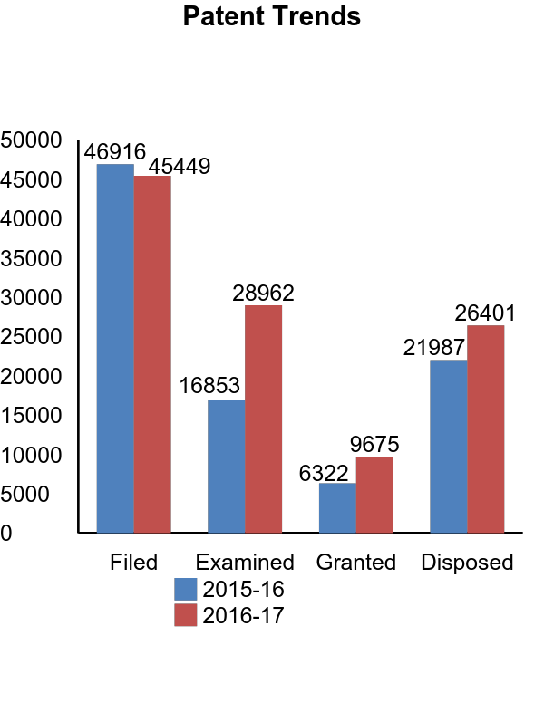
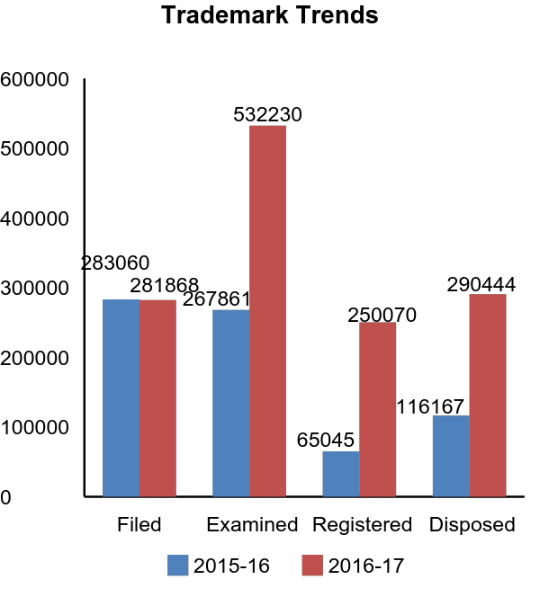
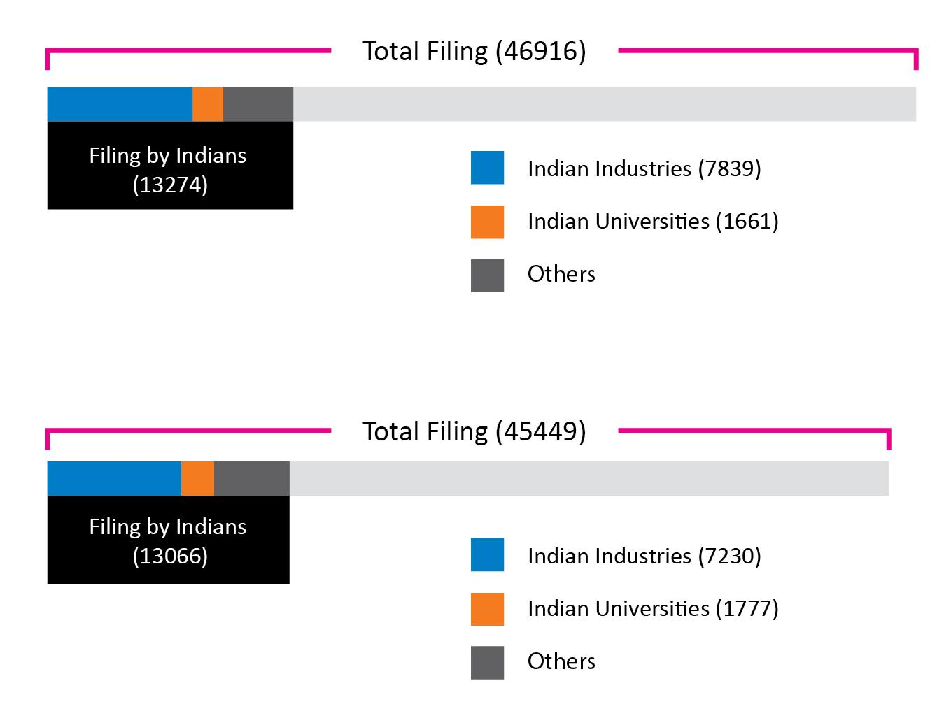
IPR TRENDS (F.Y. 2016-17 VIS-À-VIS LAST F.Y. 2015-16)

Slide 33
India on the Global IP platform
India has a Trade Related Aspects of Intellectual Property Rights (TRIPS) compliant, robust, equitable and dynamic IPR regime
The Indian IPR system maintains a fine balance between private rights through IPRs and rights of the society as public interest
India first country to ratify the Marrakesh Treaty which facilitates access to published works by visually impaired persons and persons with print disabilities
India’s patent regime prevents ‘ever greening’ and makes affordable generics possible - Millions of people around the world rely on affordable medicines made in India, making ‘India the pharmacy of the world’
Memorandum of Understanding (MoUs) in the field of IP signed with organisations, regions and nations such as WIPO, Japan, Europe, Singapore and UK: facilitate bilateral exchanges of best practices and cooperation to foster innovation and creativity
India’s ranking on Global Innovation Index (GII) shot up from 81 in 2015 to 60 in 2017
Notes:
India’s IPR Regime
Intellectual property rights is a key competitive asset in India’s ability to compete in the global economy. A robust and balanced intellectual property regime is a crucial tool for advancement of innovation, economic growth and international trade.
India has a well-established legislative, administrative and judicial framework to safeguard Intellectual Property Rights (IPRs) which meets its international obligations while utilizing the flexibilities provided in the international regime to address its developmental concerns. The Indian IP system maintains a fine balance between private rights through IPRs on one hand, and rights of the society as public interest on the other hand.
India’s ranking on Global Innovation Index (GII) shot up from 81 in 2015 to 60 in 2017
Recognizing India’s potential to reach great heights in innovation and creativity, a Task Force on Innovation was set up on the directions of Smt. Nirmala Sitharaman, the Commerce & Industry Minister, Government of India. The Task Force on Innovation had the mandate of assessing India’s position as an innovative country, and suggest measures to enhance the innovation ecosystem in India and thus improve India’s ranking in the GII. The Team, comprising of Government officials and experts from private organisations & academia, has compiled this Report to assist India in this journey.

Slide 34
IP Infringement, Enforcement and Remedies

Slide 35
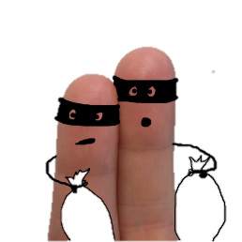
What is IP Infringement?
IP infringement is breach or violation of intellectual property rights. IPRs are said to be infringed when a work protected by IP laws is used, copied, distributed or otherwise exploited without having the proper permission from the owners
Examples of IP infringement are “trademark counterfeiting” and “copyright piracy”
Notes:
In general terms, IP infringement is any breach of intellectual property rights.
IP rights are infringed when a work protected by IP laws is used, copied or otherwise exploited without having the proper permission from a person who owns those rights.
Examples of an IP infringement are “counterfeiting” and “piracy.”
Counterfeiting is the practice of imitating genuine goods, often to inferior quality, with the intent to take advantage of the superior value of the imitated product.
Piracy is an unauthorized copying, use, reproduction and/or distribution of materials protected by intellectual property rights.

Slide 36
Counterfeiting & Piracy
Piracy refers to illegal selling, distribution and use of duplicates of copyrighted content. It may be done in various forms – soft lifting, hard disk loading, client server over use, online piracy, etc.
‘Counterfeiting’ is illegally making and selling a fake products called ‘counterfeits’ which is an identical or similar copy of a genuine product, with the same or similar trademark, logos and color combinations that misleads people to mistake it for the real product
Notes:
Counterfeiting, piracy and smuggling are emerging as the likely sources for financing of international terrorist organizations, non- state sponsored terrorist organizations and domestic terrorist groups. The menace of piracy has also assumed significant proportions, and is causing significant economic loss to the industry as well as the Government. Unfortunately, India is one of its hardest hit victims. With rising use of digital medium, online copyright piracy is assuming gigantic proportions across the globe, and no country is immune to this menace.
The problem is not unsolvable – we need to empower IP owners to enforce their rights. We believe that innovative technology based solutions; stronger enforcement mechanisms and awareness initiatives with the help of the industry may play a significant role to keep pirates at bay.

Slide 37
Remedies against IP Infringement – Civil Remedies
IPRs that provide for Civil Remedies
Civil Remedies
Copyright
Geographical Indication
Trademark
Patent
Design
Interlocutory/Permanent Injunction
An Award of Costs & Damages
Delivery Up & Destruction
Additional remedies in case of Copyright
Mareva Injunction
Anton Pillar Order
John Doe Order
Notes:
IP laws in India are governed and protected under the Patents Act, 1970; Trademarks Act, 1999; Copyrights Act, 1957; Designs Act, 2001 etc. Civil and Criminal remedies mentioned under these acts are of utmost importance for the IP rights enforcement.
The courts in India have power to grant reliefs in cases pertaining to violation and/or infringement of intellectual property rights.
The various IP laws in India mention about the provisions of civil and criminal remedies for IP rights enforcement. These civil and criminal remedies are distinct and independent. Also they can be availed simultaneously.
Civil Remedies
Upon IP infringement civil remedies can be enforced by filing a suit for infringement and/or passing off (in case of unregistered trademarks) in the competent court.
Injunction is prohibition of an action by a party to a law suit. If the plaintiff establishes that the prima facie case is in his favour, injunction is granted.
Anton Pillar orders, permits the plaintiff’s counsel to enter the infringer’s premises and seize evidence of infringement. This order is passed when there is a serious danger of removal/destruction of the infringing articles. Such an order is granted on an ex-parte application. Infringing goods are delivered to the plaintiff or destroyed if the orders of delivery-up and destruction are passed.
An award of cost and damages are two mutually exclusive remedies. Damages are granted to compensate the losses incurred by the plaintiff on account of defendant’s infringing act, whereas actual amounts of profits are handed over to the plaintiff as the second measure.

Slide 38
Remedies against IP Infringement – Criminal Remedies
Criminal remedies such as Imprisonment and Fine is available in the following Acts:
Copyrights Act,1957
Geographical Indications of Goods (Registration and Protection) Act, 1999
Biological Diversity Act,2002
Semiconductor Integrated Circuits Layout Design Act, 2000
Trade Marks Act, 1999
Protection of Plants & Varieties and Farmers Rights Act, 2001
Notes:
Criminal Remedies
Section 63 of the Copyright Act, 1957 deals with ‘Offences of Infringement of copyright or other rights conferred by the act’. It mentions about imprisonment for a term not less than 6 months which may extend up to 3 years and fine not less than 50,000 rupees which may extend up to 2 lakh rupees, as punishment if found guilty in a copyright infringement case. This term and fine can be increased according to the provisions of Section 63A of the Copyright Act, 1957.
Chapter XII of the Trademarks Act, 1999 deals with offences, penalties and procedures pertaining to trademark infringement. Here on account of trademark infringement, the punishment can go as high as imprisonment up to 3 years with or without fine. The fine ranges from 50,000 to 2 lakh rupees. This term and fine can be increased as per the provisions of the Section 105 of the Trademarks Act, 1999.
Indian Patent Act, 1970 also considers falsification of entries in register, claiming patent rights in an unauthorized way etc. to be punishable criminal offences. Such penalties are mentioned under Chapter XX of the Indian Patents Act, 1970.

Slide 39
Online Copyright Piracy: Enforcement Issues
There are a number of intricacies involved in taking enforcement action against online copyright piracy
Territorial Limitations
Anonymity
THE ONLINE PIRACY PUZZLE
Change of URLs
Statutory Safe Harbors
Notes:
Online copyright piracy is assuming gigantic proportions across the globe, and no country is immune to this menace. A possible and substantially effective solution to this problem lies in the civil remedy of website blocking orders or John Joe orders.
John Doe Orders
The judicial orders, “John Doe orders” in effect as they are issued against persons, whose identity is unknown, are targeted at specific websites, so-called “pirate” or “rogue websites”, as the overwhelming majority of the content hosted on such sites infringes copyright. Notices, even if ineffective, are still issued to the ISP and, if identifiable, to the owner of the domain and/or website in accordance with the statutory provisions. Plaintiffs are then able to obtain court injunctions ordering specific named websites to cease the infringement of their copyright.
ISPs providing Internet bandwidth connectivity are directed to enforce the injunction by blocking the access of Indian subscribers to the websites subject of the order. The concerned Government Departments are directed by the court to require ISPs act as per court orders, in accordance with terms and conditions of the license agreement they have with the Department of Telecommunication for the provision of internet services.
Recent past has seen rising trend in Indian Film Industry to obtain “John Doe” orders prior to release for blocking access to any website which might be deemed to host links to pirated content.
Anton Piller Orders
Other than the extensive police powers under the Copyright Act, plaintiffs have various civil powers to enforce their right. Copyright owners and associations can employ civil procedure to search the defendant’s premises as seize the pirated copies.
This is done via ‘Anton Piller’ orders obtained from civil courts which permit court-appointed officers, accompanied by representatives of the plaintiffs, to search premises and seize evidence without prior warning to the defendant.
Similar to John Doe Orders, these orders can be obtained unilaterally (ex-parte).

Slide 40
IPR Enforcement Toolkit
About
A ready reckoner for Police for IPRs enforcement in India
Objective
To aid in dealing with IP Crimes - Trade Mark counterfeiting and Copyright piracy in particular
Contents
Criminal Offences under Trade Mark and Copyright Acts
General Guidelines for Search And Seizure
Checklist for Registering Complaint
Checklist for Search And Seizure
Notes:
CIPAM in association with FICCI has made an IPR Enforcement Toolkit for Police. Toolkit was launched by Commerce and Industry Minister on 04th January, 2017. Toolkit will aid police officials in dealing with IP Crimes, in particular, trade mark counterfeiting and copyright piracy

Slide 41
Activity: Point out the infringements
I
Translating a book, say ‘Harry Potter Series’ in a local language with proper authorization from the author(s)/ publisher(s)
II Making a copy of a software say ‘Adobe Photoshop’ and selling it on lower price
III
Downloading the movie - ‘Raees’ using torrent sites and watching on laptop
IV
Picking up photographs from Google and uploading them on your social media platforms (like Instagram) as your own
V
Photocopying a chapter from a book to research for a project
VI Selling jeans under a label Lewi’s and trying to pass it off as an original product of Levi’s
Notes:
II, III, IV & VI are infringements

Slide 42
IP Offices, India
SICLDR #
Delhi
You can, without any fees
Search at www.ipindia.nic.in to check whether an IP application on the subject matter of your interest has been already filed or granted/registered in India
Check the status of your filed IP application
Check lapsed or ceased patents in your field of technology to either commercialize them or undertake further research.
Patent Office
Kolkata (Head Office)
Delhi
Chennai
Mumbai
Designs Wing
Kolkata
Trade Marks Registry
Mumbai (Head Office)
Delhi
Kolkata
Chennai
Ahmedabad
Geographical Indications Registry
Chennai
Copyrights Office
Delhi
www.ipindia.nic.in
# SICLDR: Semiconductor Integrated Circuits Layout Design Registry

Slide 43
How can you contribute to IP?
Think Outside the Box
Be Innovative
Think Outside the Box
Don’t Buy Fake
Produce Original Work
Don’t Buy Fake
Produce Original Work

Slide 44
Some useful links
CIPAM Website http://cipam.gov.in/
DIPP Website
http://dipp.nic.in/
CGPTDM Website
www.ipindia.nic.in/
Start-Up India Action Plan
http://startupindia.gov.in/uploads/pdf/Action%20Plan.pdf
TKDL
http://www.tkdl.res.in/tkdl/langdefault/common/Home.asp?GL=Eng
WIPO Website
http://www.wipo.int/about-ip/en/

Slide 45
Thank You “It’s time for Indians to take up their rightful place in the global arena of creativity and innovation; not only as creators and innovators, but also as owners of IP” Creative India; Innovative India रचनात्मक भारत; अभिनव भारत

